Slide 1
Digital Security and Forensics AICT014-4-2-CSF VE3
Identity and Access Management

Slide 2
Managing Identity and Access
Implement Identity and Access Management
Configure Directory Services
Configure Access Services
Manage Accounts

Slide 3
Privileged Access Management (PAM)
Privileged
Privileged access means higher access rights than other users. These elevated access rights are usually given to superusers and allow for full control of systems, applications, and data.
IAM
Identity and access management (IAM) is a framework of policies and technology that authenticates and authorizes access to applications, data, systems, and cloud platforms. In basic terms, it helps ensure that the right people have the right access, for the right reasons.
PAM
Privileged Access Management (PAM) is a subset of IAM that focuses exclusively on protecting privileged accounts—accounts granted to a small number of users who need access to backend systems, databases, and other places where highly-sensitive information is stored. PAM adds a layer of security to reduce risk, protect against external threats, and support organizational compliance.
IAM safely authorizes any user who needs access to a system.
IAM to control access to documents.
PAM limits access rights to the absolute minimum number of users necessary to perform authorized business activities.
PAM for managing servers' credentials.

Slide 4
Identity and Access Management Introduction
Identity and access management (IAM) is a framework of business processes, policies, and technologies that facilitates the management of electronic or digital identities.
With an IAM framework in place, information technology (IT) managers can control user access to critical information within their organizations.
Systems used for IAM include single sign-on systems, two-factor authentication, multifactor authentication, and privileged access management.
These technologies also provide the ability to securely store identity and profile data as well as data governance functions to ensure that only data that is necessary and relevant is shared.
Businesses leaders and IT departments are under increased regulatory and organizational pressure to protect access to corporate resources. As a result, they can no longer rely on manual and error-prone processes to assign and track user privileges. IAM automates these tasks and enables granular access control and auditing of all corporate assets on-premises and in the cloud.

Slide 5
Benefits of Identity and Access Management
IAM technologies can be used to initiate, capture, record and manage user identities and their related access permissions in an automated manner. An organization gains the following IAM benefits:
Access privileges are granted according to policy, and all individuals and services are properly authenticated, authorized, and audited.
Companies that properly manage identities have greater control of user access, which reduces the risk of internal and external data breaches.
Automating IAM systems allow businesses to operate more efficiently by decreasing the effort, time, and money that would be required to manually manage access to their networks.
In terms of security, the use of an IAM framework can make it easier to enforce policies around user authentication, validation, and privileges, and address issues regarding privilege creep.
IAM systems help companies better comply with government regulations by allowing them to show corporate information is not being misused. Companies can also demonstrate that any data needed for auditing can be made available on demand.

Slide 6


Identity and Access Management
A security process that provides identity, authentication, and authorization mechanisms for entities to work with organizational assets.
You can define attributes in an identity, such as purpose, function, clearance, etc.
Attributes enable access systems to make decisions for authentication and authorization.
Example: Employee role factors into identity, like department and managerial status.
IAM is crucial for bolstering overall IT security.

Slide 7
Access Control Models
The access control component of IAM can be implemented in several different ways. The following table outlines the major access control that can be deployed.
Access Control Model | Description
Mandatory Access Control (MAC) | Compares object's security designation with subject's clearance level. Clearance level must meet or exceed designation to gain access. Security labels usually changed by administrator only.
Discretionary Access Control (DAC) | Access to object is controlled through Asset Control Lists (ACLs). Owner can place the subject on ACL or not. Object owners can usually modify object ACLs.
Role-based Access Control (RBAC) | Subjects assigned predefined roles. Subject must be in a certain role to access object. Roles assigned to subjects based on policies.
Rule-based access control | Based on operational rules or restrictions. Restricting access based on time of day is an example. Rule sets examined before subject is given access to objects.
Attribute-based Access Control (ABAC) | Based on set of attributes the subject possesses. Follows if x, then y procedure. Example: If subject has all required attributes, then grant access. Attributes are created ahead of time and assigned as needed.

Slide 8

Physical Access Control Devices
Many organization's can't rely solely on software-based access control.
Devices can be a subject's token or the authenticating device itself.
Devices can work with both physical controls and virtual controls.
Subject token example: smart cards and proximity cards.
Authenticating device example: card reader.
Some authenticating devices work with other factors (e.g., biometrics).

Slide 9





Biometric Devices
Fingerprint scanners
Capture live image of person's fingerprint.
Virtually unique to each individual, so reasonably accurate.
Voice recognition devices
Person speaks into a microphone which records a voiceprint.
System attempts to match voiceprints.
Voice can be recorded and replicated, but is difficult to accurately mimic.
Retinal scanners
Scan blood vessels in retina portion of the eye.
Blood vessels are complex; don't change except from disease or injury.
Invasive as it requires the device to be very close to the eye.
Iris scanners
Scan the entire iris of a person's eye.
Capture near-infrared image from comfortable distances.
Iris is less likely to be affected by diseases.
Facial recognition devices
Take digital image of entire face.
Identify unique features like distance between eyes, nose length and width, etc.
Prone to error due to changes in lighting, hair, makeup, etc.

Slide 10
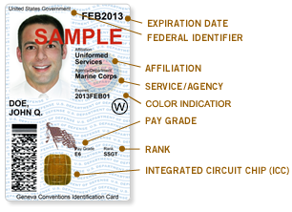
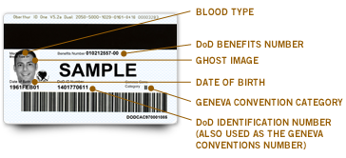
Certificate-Based Authentication
Digital certificates prove identity of public key owner.
Used by civilian federal employees and contractors.
Used to access facilities and systems.
Personal Identity Verification (PIV): Federal standard for tamper-resistant and authentication-providing cards that use digital certificates.
Common Access Card: PIV-like smart card for Department of Defense (DoD) personnel that provides certificate-based authentication.

Slide 11


File System and Database Access
Access control to file systems depends on type and operating system.
You may be able to implement an access control mode like Discretionary Access Control (DAC).
Example: Active Directory in Windows.
Maintains Access Control Lists (ACLs) of what subjects can access an object.
You can set granular permissions.
Employee with read-only access to department's network folder.
Can also create new subfolders.
Can't modify files or delete higher-level folders.
Database access control depends on software implementation.
Typically control access to specific database elements, like a table.
Also control access based on commands.
Selecting, updating, modifying, and creating elements.

Slide 12
Guidelines for Implementing IAM
Consider adding IAM to the overall security management process.
Familiarize yourself with access control models.
Decide on access models that uphold business, security, and environment needs.
Consider implementing physical access control devices like smart cards.
Recognize strengths and weaknesses of biometric devices.
Consider implement biometric devices like iris scanners.
Consider implementing certificate-based authentication devices.
Consider that Personal Identity Verification (PIV) or Common Access Cards (CACs) may be mandatory in federal environments.
Implement access control models at the file system level.
Implement access controls that come with database software.

Slide 13
Configure Directory Service

Slide 14
Directory Services
A network service that stores identity information about all objects in a particular network.
Objects can include:
Users
Groups
Servers
Clients
Printers
Network services
Centralizes security for controlling access to network resources.
Structure is based on a hierarchy of objects.
Starts with root and branches out to other objects.
Helps categorize objects in a network.

Slide 15
Directory Services (Cont.)
Develetech
US
Sales
EU
R&D
John
Mary
Marketing
IT
Marcus
CRM Server
Alyssa
Marketing Website
Jeremy
Gloria
Francis
VPN Server
Workstation
Company
Region
Department
Users and Computers

Slide 16
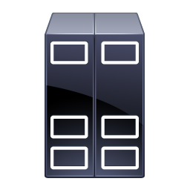


Lightweight Directory Access Protocol (LDAP)
A directory service protocol that runs over TCP/IP networks.
LDAP clients authenticate to LDAP service.
Schema defines:
Tasks clients can and cannot perform while accessing directory.
The form a directory query must take.
How directory server will respond.
Schema is extensible.
LDAP Client
Directory query
LDAP Server
LDAP Client
Directory query
Stores directory
data

Slide 17



Secure LDAP
A method of implementing LDAP using SSL/TLS encryption.
Prevents eavesdropping and man-in-the-middle attacks.
Forces client and server to establish secure connection first.
Closes the connection if it is interrupted.
LDAPS server requires signed certificate.
Client must install certificate on their machine.
LDAP Client
Signed certificate
Trusted session
LDAP Server
LDAP Client

Slide 18
Common Directory Services
Directory Service | Description
Active Directory | Directory service by Microsoft. Holds network object info for one or more domains. Admins can manage object access through ACLs. AD LDS is a lightweight version.
Oracle Directory Server Enterprise Edition (ODSEE) | Marketed toward large installations that require reliable scaling. Free, but paid support is available. Formerly known as Sun Java System Directory Server.
OpenDJ | Open source cross-platform directory service written in Java. Supports LDAPv3 and DSMLv2. Based on Sun's OpenDS service.
OpenLDAP | Open source cross-platform LDAP implementation. Included in many Linux distros.
Open Directory | Apple's custom implementation of OpenLDAP. Available for macOS Server. Some compatibility with Active Directory.

Slide 19
Configure Access Services

Slide 20
Remote Access Methods
Organizations can provide users with several methods of remote access.
Customers and employees can remotely access network resources.
A gateway RAS can provide access control to all or part of a network.
An intermediate network like the Internet can also provide remote access.
Security personnel must secure transmissions that pass over a public network.

Slide 21





Tunneling
A data-transport technique in which a data packet is encrypted and encapsulated in another data packet.
Tunneling conceals information of the inside packet.
Hides user-encrypted data from carrier network.
Used in remote access protocols, typically in VPN.
Carrier Protocol
Encapsulating Packet
Original Packet

Slide 22
Remote Access Protocols
Protocol | Description
PPP (Point-to-point protocol) | Legacy standard for sending datagram packets over point-to-point links. Commonly used for dial-up Internet access. PPPoE and PPPoA are more recent and used in DSL. Provides encryption for passwords and secure authentication.
PPTP (Point-to-point tunneling protocol) | Microsoft VPN layer 2 protocol. Provides tunneling and encryption for PPP packets. Common in older Windows clients; no longer recommended.
L2TP (Layer-2 tunneling protocol) | Combination of PPTP and L2F for tunneling PPP across network protocols. Designed for client-to-gateway and gateway-to-gateway secure connections. Does not provide encryption on own; often used with IPSec.
SSTP (Secure Soket tunneling protocol) | Uses SSL/TLS to encapsulate packet with PPP header and then SSTP header. Packet and both headers are encrypted by SSL/TLS. Supported in current Windows operating systems.

Slide 23
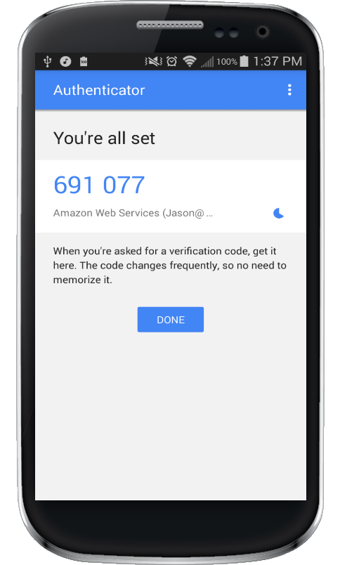
HMAC-Based One-Time Password
An algorithm that generates a one-time password using a hash-based message authentication code to ensure authenticity.
OTPs are meant to replace or supplement insecure static passwords.
Valid only for that session.
Attacker who steals the OTP will be unable to use it after the user's session.
OTPs provide interoperability across hardware and software platforms.
Most major mobile operating systems support HOTP.

Slide 24

Time-Based OTP
Adds to HOTP by introducing a time-based factor to OTP authentication.
HOTP is only invalidated after used to successfully authenticate.
Allows an attacker to take advantage of the password if it is never used.
TOTP addresses this flaw by invalidating the password after a time.
Attacker must steal password within time period.
Difficult to carry out attack this quickly.
Useful defense against authentication abuse.

Slide 25



Password Authentication Protocol
An authentication protocol that sends user IDs and passwords as plaintext.
Typically used when a remote client is connecting to a non-Windows server.
Server receives user ID and password, then compares to a list of credentials.
Allows remote access to resources if match is found.
Lacks encryption and should be avoided.
Remote Client
Unix Server
Request is sent
Credentials are verified

Slide 26
Challenge-Handshake Authentication Protocol
Encrypted authentication protocol used to provide access control to remote access servers.
Developed so passwords wouldn't need to be sent in plaintext.
Typically used to connect non-Windows servers.
Use MD5 hashing and challenge-response mechanism.
Can accept connections from most authentication methods.
Considered obsolete due to weaknesses of MD5.
1. Directory query
2. Challenge
3. Response
Remote Client
4. Logon accepted
RAS

Slide 27
NT LAN Manager
A challenge-response authentication protocol created by Microsoft and first released in early versions of Windows NT.
NTLM process:
Client establishes connection to server.
Server responds with a challenge to establish client's identity.
Client responds to challenge with authentication information.
Weak to brute force cracking attempts due to outdated encryption algorithms.
Weak to pass the hash attacks.
Discouraged by Microsoft.
Kerberos is preferred in Active Directory domains.

Slide 28



Authentication, Authorization, and Accounting
A security concept for a centralized platform that performs three separate identity-based tasks.
Tasks are:
Verifying object identification (authentication).
Ensuring object is assigned relevant permissions (authorization).
Logging actions to create an audit trail (accounting).
AAA solutions are the gatekeepers that provide access to network services.
Authentication
Authorization
Accounting

Slide 29
Remote Authentication Dial-In User Service
Remote Authentication Dial-In User Service: An Internet standard protocol that provides AAA services.
You configure an access server as the RADIUS server.
Other access servers are RADIUS clients.
Clients pass authentication requests to server for verification.
Centralizes user configuration, remote access policies, and usage logging.
Network access server: The general term for a remote access server used in RADIUS.

Slide 30

Remote Authentication Dial-In User Service (Cont.)
Access servers receive requests and pass credentials to RADIUS server
Remote clients connect to access servers
RADIUS server accepts and processes all authentication requests
RADIUS Server
Remote Clients
Access Servers
Configured as
RADIUS Clients

Slide 31
Terminal Access Controller Access-Control System (TACACS)
Terminal Access Controller Access-Control System/TACACS Plus: Protocols that provide AAA services for remote users.
TACACS+ is more secure and scalable than RADIUS.
Accepts login requests and authenticates user based on credentials.
Encrypts all data in authentication transmissions, not just password.
Separates authentication from authorization, instead of combining into one packet.
Original TACACS and XTACACS are superseded by TACACS+.
No native Windows support, but some solutions are available.
Solutions also available for Linux systems.

Slide 32
Kerberos
An authentication service based on a time-sensitive ticket-granting system.
Developed by MIT to use a single-sign on method of access.
User credentials are passed to authentication server.
Authentication server has an access list and allows access based on credentials.
Centralized authentication server manages access to a variety of resources.
Often used with Active Directory to authenticate users in a domain.
Employs mutual authentication.
Uses modern encryption standards to improve on NTLM and other protocols.

Slide 33


Kerberos (Cont.)
1. User logs in to domain
2. User requests TGT
3. Auth server responds with time-stamped TGT
4. User requests service ticket to resource
5. Auth server responds with service ticket
Domain Controller
6. User presents service ticket to resource
7. Resource authenticates user
File Server

Slide 34
Manage Accounts

Slide 35

Account Management
The processes, functions, and policies used to effectively manage user accounts in an organization.
Specific IAM function.
Admins can create, update, modify, and delete accounts tied to identities.
User accounts allow or deny access to information systems and resources.
With proper controls in place, the organization can manage accounts.

Slide 36

Account Privileges
User accounts are provided with permissions such as accessing files and services.
Can be user-assigned for unique job functions/tasks.
Can also be group-based.
Assigned to groups of users.
Each user in group has the same permissions.
Effective for grouping users by department (i.e., RBAC).
Considered best practice.
A user with unique privileges and who is also a member of a group will have both sets of privileges.
Both should be well-documented in policy.

Slide 37
Account Types
Account Type | Description
User accounts | Standard account type for general users. Usually limited in privileges. Usually restricted from modifying sensitive data or systems.
Privileged accounts | Greater access rights than standard user account. Admins need elevated privileges to fulfill duties. Usually reserved for IT personnel, but sometimes needed for users.
Guest accounts | Provided to non-personnel who need limited access. No password or identifying information. Can't create, modify, or delete files. Example: Sign in public users at a kiosk or terminal.
Computer and service accounts | Non-human entities also need accounts. Computers and services may need access to other computers and services. Example: Web server needs to retrieve data from a products database.

Slide 38

Account Policy
A document that includes an organization's requirements for account creation, monitoring, and removal.
Can include user-specific or group-based requirements.
Details can vary and can be customized and enforced based on business needs.
You need to research and analyze policy details.
Common policy statements:
Account approval.
Resource usage.
Shared/multiple account usage.
Account disablement/modification.
Account expiration.
Account prohibition.
Password usage.
Account lockout.
Account recovery.

Slide 39
Password Policy
Password length
Protects against brute force cracking.
Cracking time increases exponentially with every character.
amsnp may take seconds to crack; amsnpcjnyk may take years.
Password complexity
Types of characters used and the formatting of those characters.
Complex password may require special characters, numbers, and lower/uppercase letters.
amsnpcjnyk becomes 4mSn!cjnyk; attacker must use more characters for each round.
Password history
Users must change passwords every so often.
Creates a "moving target" for attackers.
Password remembering forces users not to choose the same passwords over and over.
Password reuse
Prevents person from using same password for multiple accounts.
If one account is compromised, the others are at risk.
Not fully enforceable on a technical level.

Slide 40
Multiple Accounts
A user has several accounts on the same system.
Accounts differ by level of access and/or role.
Issues:
Lack of user awareness of accounts.
Assigning right level of access for each account.
Managing privileges and data replication for each account.
Common use case for multiple accounts:
Admins have an admin account and a standard user account.
User account is for daily, non-privileged work.
Admin account is for configuring systems and other accounts.
The admin may need to switch between accounts quickly and easily.
May be challenging to support account switching without disruption.

Slide 41
Shared Accounts
Accessed by more than one user or resource.
Not associated with an individual, but rather a role or purpose.
Examples:
Guest or generic accounts.
Temporary contractor accounts.
Admin accounts for a group.
Batch process accounts.
Inherently risky, as it is difficult to hold individuals accountable.
Users may become careless.
Password changes may also be difficult to manage.
If you use shared accounts, be discreet with access privileges.

Slide 42
Account Management Security Controls
Control | Description
Standard naming conventions | Reduce confusion by naming accounts consistently. Refrain from using nicknames or anonymous user names.
Account maintenance | You will need to modify or remove accounts. Have a plan in place to avoid missing necessary changes.
Onboarding/offboarding | New employees should have new accounts in a timely manner. Terminated employee accounts should be removed as soon as possible.
Access recertification | Perform regular permissions audits to uphold least privilege. Can help you identify what accounts need modification.
Usage auditing | You should also monitor how accounts are used. Can help you spot malicious behavior.
Group-based access control | Place users into groups for easier management. Helps you understand each user's job function.
Location-based policies | Restrict physical and virtual locations from which users gain access. Can help mitigate remote attacks from unknown sources.
Time-of-day restrictions | Attackers may gain access during off-hours to avoid detection. Restrict access to only when the employee is working.

Slide 43
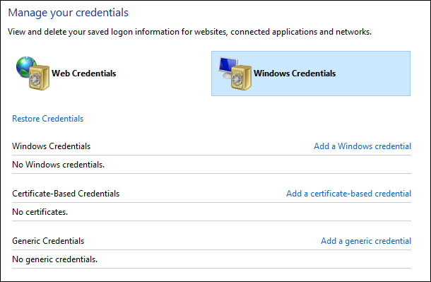
Credential Management
Credential Manager: A tool that stores and organizes account credentials.
Stores credentials in an encrypted database.
User can retrieve credentials when needed.
Credential managers can automatically fill in forms with user names/passwords.
Doesn't protect against weak passwords being stolen.
If database is password-protected, the master password must be secured.
Use MFA with credential managers for best results.

Slide 44
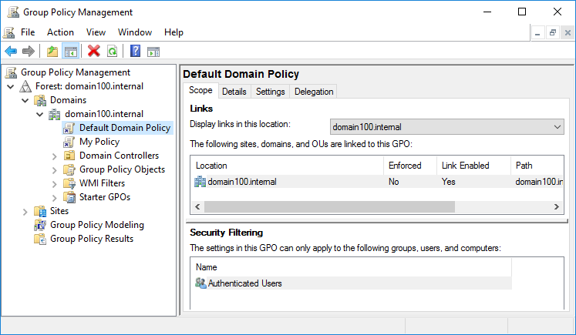
Group Policy
Provides methods for managing account security across a Windows domain:
Enforcing password length, complexity, age, etc.
Enforcing account lockout thresholds/durations.
Storing account passwords using encryption.
Enforcing Kerberos logon restrictions and ticket lifetimes.
Auditing account management events.
Assigning specific rights to individual or group accounts.

Slide 45





Identity Federation
The practice of linking a single identity across multiple disparate identity management systems.
Encompasses all policies and protocols that contribute to such an identity.
Provides centralized management structure for identities.
Streamlines user experience into a single account.
Can create a single point of compromise.
SSO is a subset of federation:
Eliminates need to sign in more than once.
Not all federated identities use SSO.
Microsoft Account

Slide 46
Identity Federation Methods
Identity Federation Method | Description
SAML | XML-based framework for exchanging security-related information. Communicated in assertions over HTTPS. Conveys identity of subjects and authorization decisions. Clients request assertions from SAML authorities.
OpenID | An authentication method for participating sites. User registers with OpenID system and signs in to sites with a single account. Site verifies identity with OpenID. Used by companies like Google and Amazon.
OAuth | Similar to OpenID, but provides authorization instead of authentication. Authorization server grants access token to user on behalf of a resource. User presents token to resource, which determines access rights. Used by sites like Google, Twitter, and Facebook.
Shibboleth | Based on SAML and often used by universities or public service organizations. User attempts to retrieve resources from Shibboleth-enabled site. Site sends SAML authentication info over URL queries. User goes through an identity provider to authenticate using this SAML info.

Slide 47
Guidelines for Managing Accounts
Uphold the principle of least privilege.
Draft an account policy and include all necessary requirements.
Verify that account request and approval procedures exist and are enforced.
Verify that account modification procedures exist and are enforced.
Draft a password policy and include strong password requirements.
Limit the use of multiple and shared accounts.
Implement account management controls like auditing and usage restrictions.
Store user names and passwords in encrypted databases.
Implement a group policy for wider access control.
Consider implementing an identity federation system.
Consider how a federated identity may be a single point of failure.

Slide 48
Reflective Questions
What experience do you have with access control? What types of access control services are you familiar with?
What account management security controls have you come across in your current job role? Do you think they are sufficient in properly protecting access?

Slide 49
Summary of Main Teaching Points
Implement Identity and Access Management
Configure Directory Services
Configure Access Services
Manage Accounts

Slide 50
Question and Answer Session
Q & A

